Slide 1
E-Commerce Website For Automotive Parts
Name : Jishnu Nambiar (Enrollment No : EBEON0322578300)
Name :- Sudhir Kumbhar (Enrollment No : EBEON0322584185)
Name: Sateeswarbabu Katem (Enrollment No :EBEON0322571885)
Name: Ranjini Devi.R (Enrollment No : EBEON0322579232)
Name: Sanjai.S (Enrollment No : EBEON0322574368)
Guided by :
Mr. Vardharajan

Slide 2
Introduction
Autoparts plus is user friendly e-Commerce website which provides user an option to buy any automotive parts for their vechile from online within few steps.
As an admin you will be able to add your on categories and product in the website which will be displayed to the user for buying.
We have also include an online payment option which will help user to pay for the products online itself.

Slide 3
Software and Hardware Reqiurements
Software Reqiurements.
Eclipse IDE
Programming languages-Java, Springboot.
JDK 17
Frontend –HTML, CSS, Bootstrap
Database –MySQL
Hardware Reqiurements.
Processor –11th Gen Intel Core(TM) i5-1135G7 @2.40Hz 2.42Hz
Speed -2.40Hz 2.42Hz
RAM- 8GB
Hard disk – 512GB

Slide 4
E-Commerce Website for Automotive Parts.
Modules:
Homepage
Login and Registration
Shop
View Product
Cart
Payment
Admin Module
Chatbot

Slide 5
E-Commerce Website for Automotive Parts.
Modules:
Shop
Product View
Sub Modules:
Timeline
Show Categories Products
Products Datails

Slide 6
E-Commerce Website for Automotive Parts.
Shop (1st Module)
Definition:
Shop is a webpage of the website from where a user can show all type automgationotive Subpart show different page responsive webpage with Attractive design.
Sub Module Datails:
TImeline.the special offer product start Date & Time end Date & Time Show
Only All Of Sale Special Offer ProductsShow All Products With Products Image
All Datails Products Information Is Products Name, Products Categories, Products Price, Products Weight in grams, Product Description Products Images.
Module Interconnection Datails:
Hare the navigation bar is Present throughout the website Connected to home page, login page, shop page and cart page.
The Shop Show Different Categories All Categories Products, Special Offer Products, Engine Type, Break System etc
View Product

Slide 7
View Product (2nd Module)
View Products
The View Prooduct (VPD) A product detail page, also known as a VPD, is a web page on an eCommerce website that provides information on a specific product. This information includes size, color, price, shipping information, and other relevant information customers want to know before purchasing.
Sub Module Datails:
Products Datails:
The User Products Buy So Firstly User See Information show Datails Example Products Weight, Products View Click On The Buy Product Go to Cart Products.

Slide 8
Continued…
Goal of module:
shoppage is the third page of our website which has a navigation bar to redirect the user to different pages of the website.
shop module is neccessary if the show products user wants to buy the product. We have also Included Timeline (Date Show start special offers) which makes it easier to shop onto our website.
Different Categories Products:
The Shop Show Different Categories All Categories Products, Special Offer Products, Engine Type, Break System etc

Slide 9












Project Overview
Admin
User Details
Login
Add Category
Add Product
Logout
Homepage
Shop
Chatbot
Payment
View Product
Add To Cart
Checkout

Slide 10
Tech architecture
1.)Data JPA Security
2.)Oauth2-Client
3.)Thymeleaf
4.)DevTools
5.)Web
1.)HTML
2.)CSS
3.)JavaScript
4.)BootStrap
1.)Java
2.)Spring Boot
3.)Hibernate concepts
Spring Boot
Browser
FrontEnd
BackEnd
Hibernate
MySQL
1.)Object Persistence
2.)Mapping with POJO
3.)Database Connection
1.)DDL
2.)DML
3.)DCL
4.)TCL

Slide 11
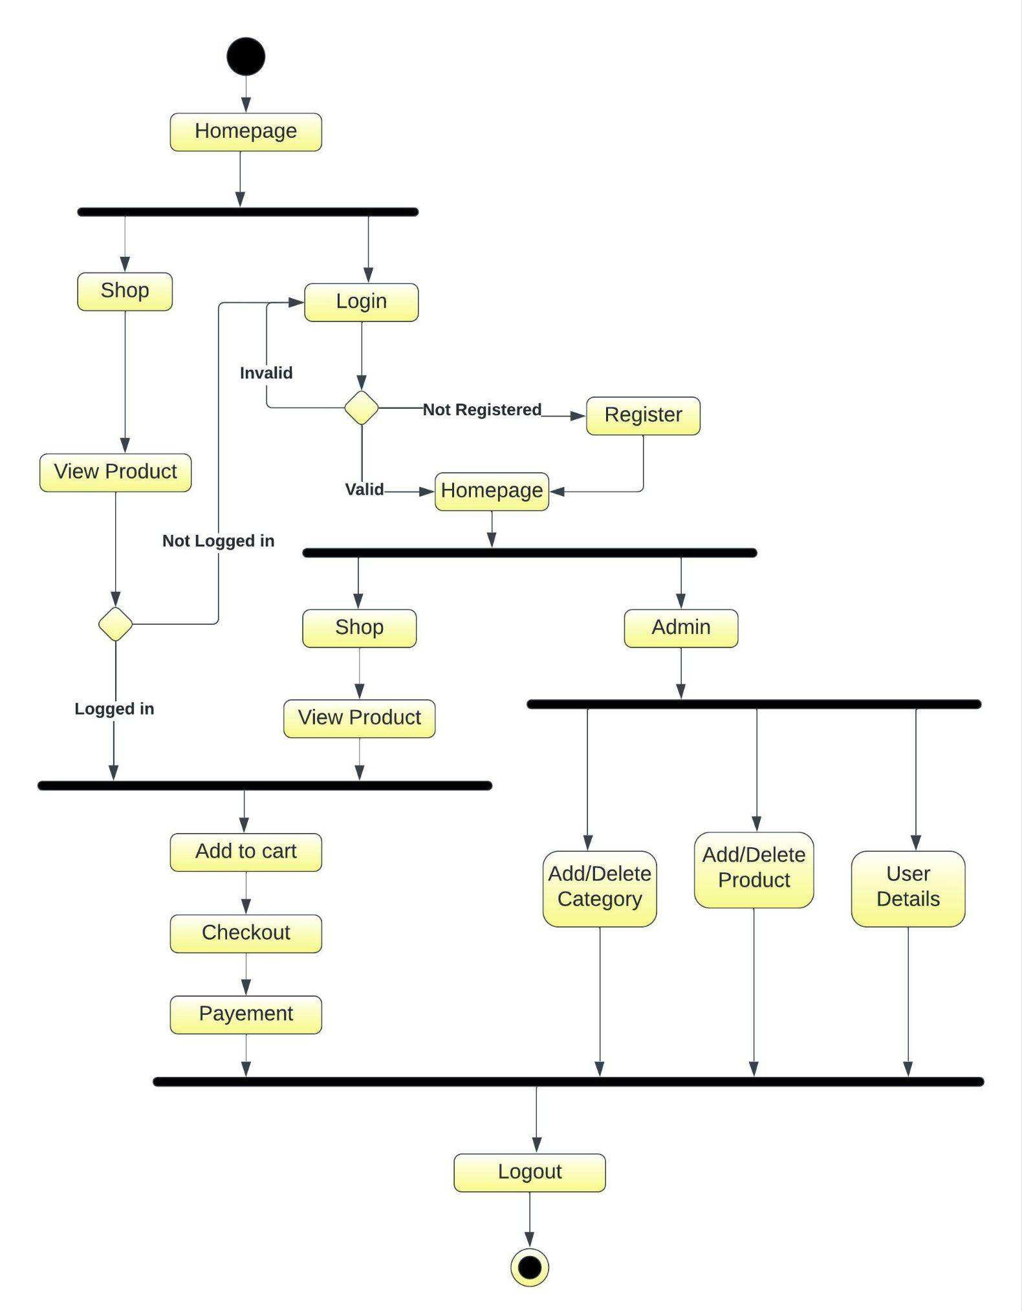
Activity Digram

Slide 12
Challenging issues
Shop error was faced. timeline in inserting the value into date & time. This error was faced due to formate date & time, I resolved it by naming it properly.
Shop page faced an error of not redirecting to the Shop page. This error was faced due to unnecessary or wrong references to css and js files. This error was resolved by giving the proper path to that specific files.

Slide 13
Features about the module
Shop and module has a Timeline feature, which helps in easy show product in with the Shop website. With help of Special offer Product But end while user don’t have to their product.
The webpages have amazing transition effect to it.
It has a user friendly interface, where the users will find it easy to use.

Slide 14
Future enhancement
To add Sell product option, where user will also be able to sell their own products.
Add more Single Sign On links like facebook, twitter, etc.
Include stock management.
User profile including orders history.

Slide 15
Quality improvement task
Approached Testing :
Junit and basic validations.
DevOps tools:
MySQL Workbench, Github, Maven
UI approach
HTML, CSS, Bootstrap.

Slide 16
Conclusion
In this project we have built an ecommerce website specially designed for automotive parts. With online payment and may more facilities.
Which has user friendly interface for easy use purpose.
We have implemented the CRUD operations with hibernate and spring boot for easy use of the project.
With this we conclude that this project has almost fulfilled all the basic necessities of an ecommerce website.

Slide 17
THANK YOU
Presented By :
Sudhir Kumbhar

